Slide 1
Android testing and publishing
Module VI

Slide 2
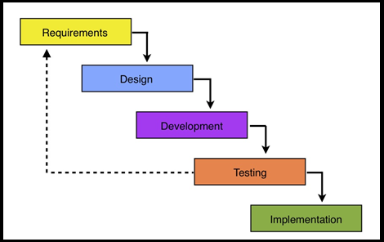
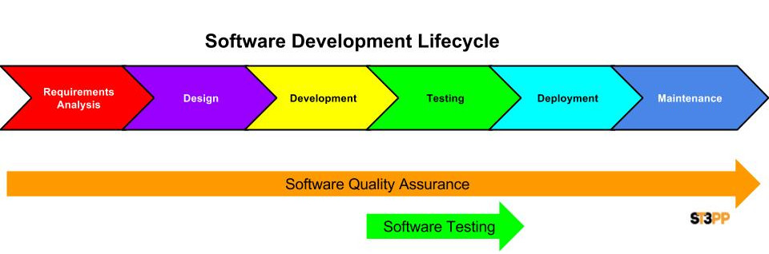
Testing and Software Development
Testing an important “step” in SW development

Slide 3
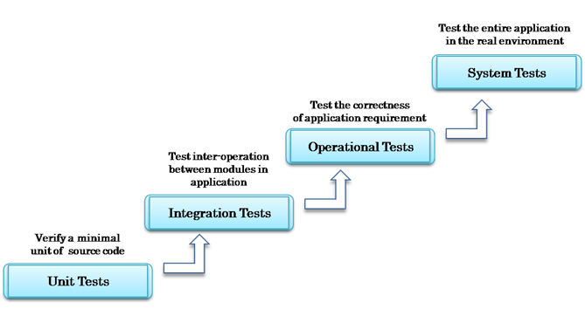
Testing Strategy in General
Start with Unit Test and end with System Tests

Slide 4
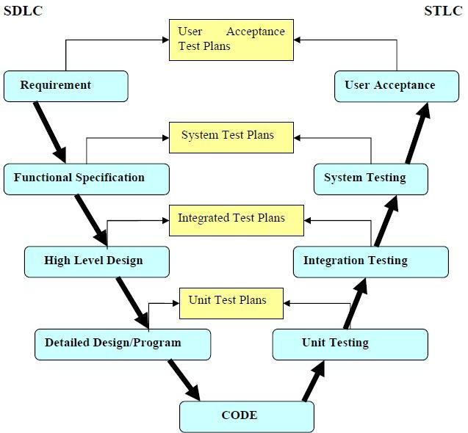
Another view of testing strategies
For each “level” of design we have a corresponding “kind” of testing that can exercise/test the fulfillment of the design in the code

Slide 5
Some Terms
Units/Modules
showing connectivity
B
C
A
Unit Testing:
Testing a module by itself. Just test A alone or E alone
Integration Testing:
tests groups of modules that have passed unit testing.
Test A,B then A, C and so on
System Testing:
Full integration testing, testing of complete system
Acceptance Testing:
process of testing system in its real environment with real data
D
E

Slide 6
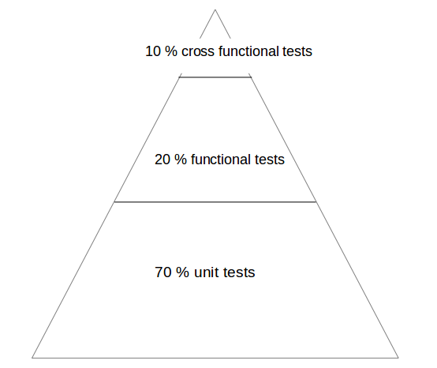
What kind of testing are we covering???
Unit Testing
Which is good because that is most of the testing you may do (see recommendation →70%) and it is the first kind of testing to do

Slide 7
Setting up for Unit Testing
With Android Studio

Slide 8
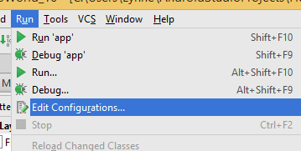
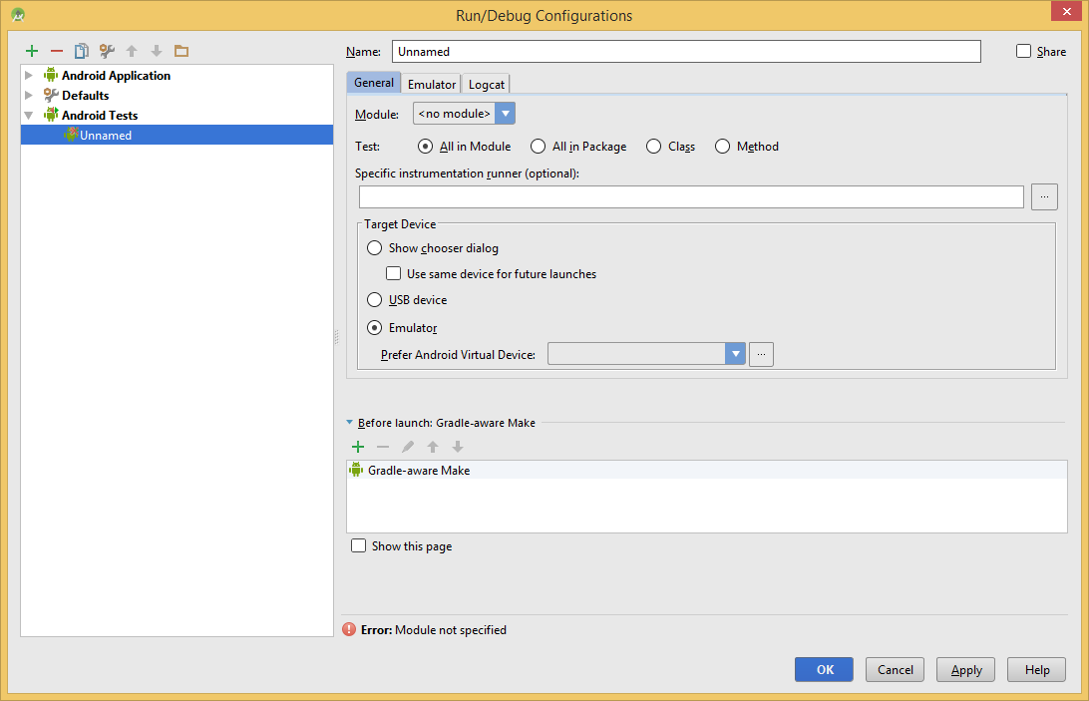
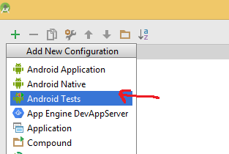
Setup Configurations
STEP 1:Run->Edit Configurations
STEP 2: Hit + in Config window and add Android Tests

Slide 9
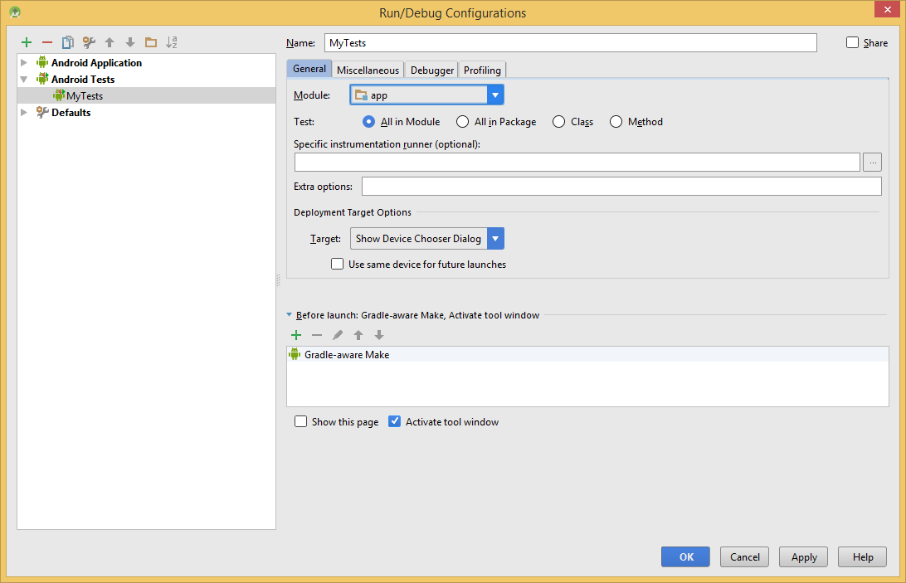
Setup continued
All test methods MUST start with the “test-” prefix or Android Studio will not detect them as tests and you will get all kinds of weird errors and nothing will work.
Step 3: Now configure Testing configuration to point to the module of your app
select“All in Module” and Android Studio will automatically find any test inside your whole Module! You can also get more specific and select “Class” or even “Method” option to narrow the scope of your testing down further.

Slide 10
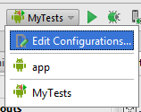
Setup finished
Step 4: after saving config in Step 3 you can see it is an option for running (now we have the app itself and the testing classes) → NEXT how do we make the testing code

Slide 11
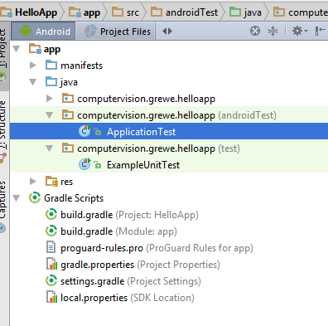
When you create Project –you have testing directories (test and androidTest)
Look at this example for a simple HelloApp app
Have androidTest and test

Slide 12
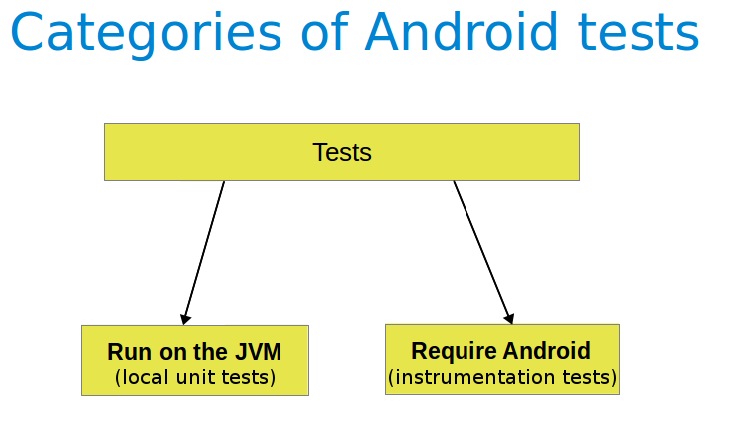
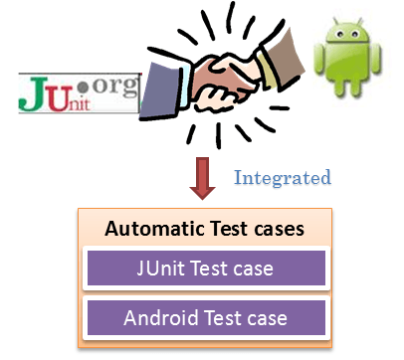
2 kinds of Unit Tests- JVM run (plain old jUnit) and Android Run (Instrumentation)
JVM = java/test Android= androidTest/

Slide 13
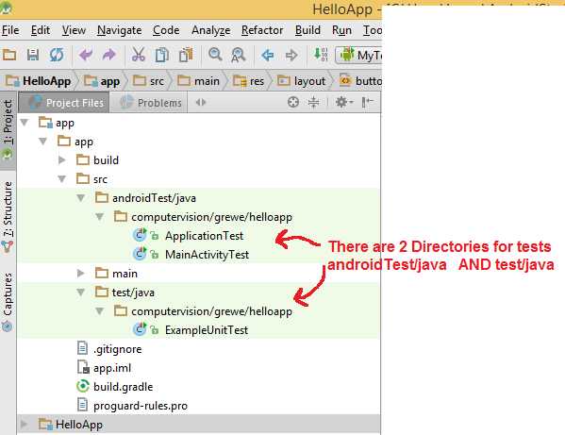
Stop ---why 2 test directories???
2 kinds of Unit Testing in Android:
androidTest/java & Tests
androidTest/java:
Used for Android classes
test/java:
Used for Plain Old Java classes –that have no Android code in them

Slide 14
test/java Tests
To allow running Android unit tests on the JVM, the Android Gradle plug-in creates a special version of the
android.jar (also known as the Android mockable jar).
Run on computer’s JVM
Use these tests to minimize execution time when your tests have no Android framework dependencies or when you can mock the Android framework dependencies

Slide 15
androidTest/java Tests
Called androidTest or instrumentation Testing –as run on “instrument” emulator or hardware device
Run on Android emulator/hardware device
Use these tests when writing integration and functional UI tests to automate user interaction, or when your tests have Android dependencies that mock objects cannot satisfy.

Slide 16
androidTest or test???
If classes do not call the Android API → you can use the JUnit test framework without any restrictions.
If you have dependencies to the Android API → these dependencies in your code must be replaced for the unit tests via a mocking framework like Mockito.
test = when not making calls to Android system need to test
androidTest = when need calls to Android system

Slide 17
Creating A Testing Class
Setting up in Android Studio

Slide 18
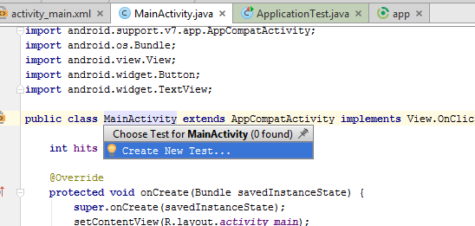
Steps to generate a Test Class
Step1: Open up the class you want to create a test class for
Step 2: select name of class and hit “Cntrl-Shift-T” and a pop-up will ask you to make a new test class

Slide 19
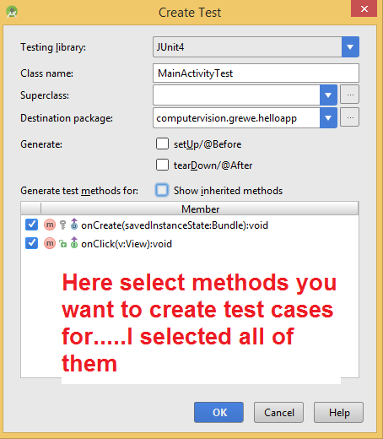
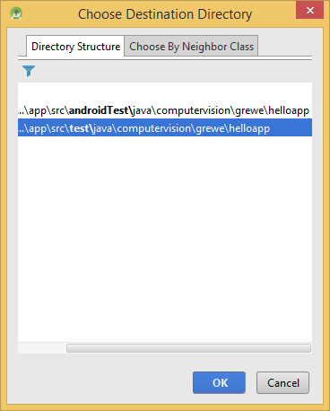
Steps to generate a Test Class
Step 3: change name (if desire) of test class, select methods you wish to create test cases for
Step3 : ALSO choose the directory test OR androidTest
NOTE: there are different Testing Libraries the Android Studio will support and generate…we are using JUnit4
Choose which directory
test = runs on JVM
androidTest =runs on android

Slide 20
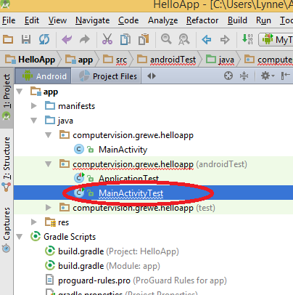
Steps to generate a Test Class
Step 4: you will see the new Test Class in the directory you specified
We choose to put it in the androidTest –so will run on Android instead of local JVM

Slide 21
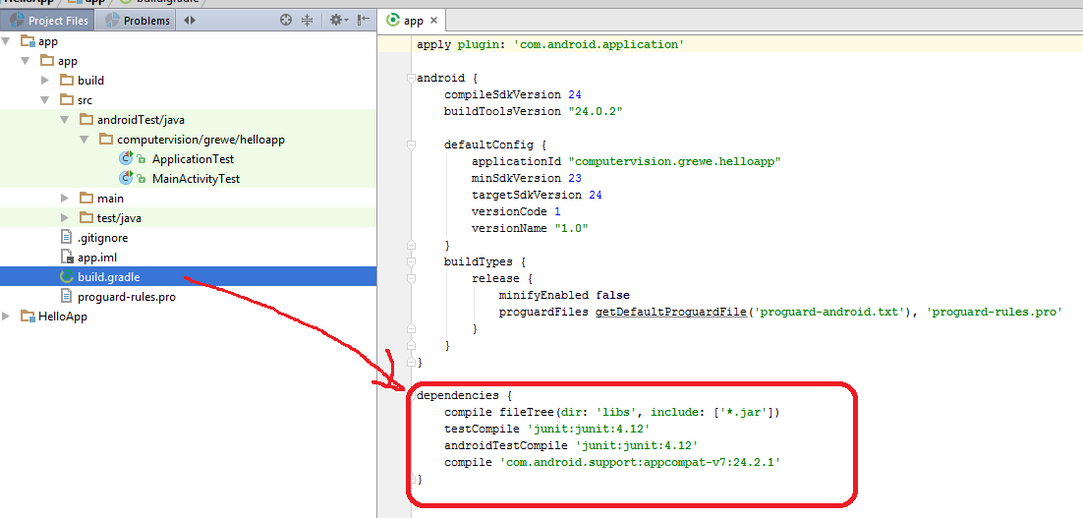
Steps to generate a Test Class
Step 5: showing for Instrumentation test (androidTest/java):
IMPORTANT: → This for androidTest/java tests
dependencies { // Required for instrumented tests androidTestCompile 'junit:junit:4.12‘ androidTestCompile 'com.android.support:support-annotations:24.0.0' androidTestCompile 'com.android.support.test:runner:0.5‘ androidTestCompile 'com.android.support.test:rules:0.5' // Optional -- Hamcrest library androidTestCompile 'org.hamcrest:hamcrest-library:1.3' // Optional -- UI testing with Espresso androidTestCompile 'com.android.support.test.espresso:espresso-core:2.2.2' // Optional -- UI testing with UI Automator androidTestCompile 'com.android.support.test.uiautomator:uiautomator-v18:2.1.2' // whatever else you have***** }

Slide 22
SPECIAL NOTE: For androidTest/java tests you need to also add this
Step 5 (only if androidTest instrumentation test) : add the following to your application’s Build defaultConfig( build.gradle file) should include:
defaultConfig {
// whatever else you have**********
testInstrumentationRunner "android.support.test.runner.AndroidJUnitRunner" }

Slide 23
Project Review - III
Date: 04-11-2019
Venue: In Class
Requirements
Team Members
Implementation of project
Marks: 30

Slide 24
Android App Publishing

Slide 25

PUBLISHING AN APP ON
GOOGLE PLAY STORE
@patel8490

Slide 26

First Lets Look How to Export APK :
• First Step is to Generate APK
• Firstly, .apk stands for Android Package.
• Application needs to generate .APK .
1. Right click the project click on Export.
2. Double Click on the Android folder and click on EXPORT ANDROID APPLICATION.
3. Select project do you want to export.
4. Generate a new key if we are exporting for the first time and show the path where you
need to store the key and provide a password for its encryption.
5. When you click next a dialog appears where the details for key comes where you can enter
alias, validity for key password etc. Then click Next where the dialog asks for the destination
where you want to store the apk file and Bingo….
6. Its Done. APK is generated.

Slide 27
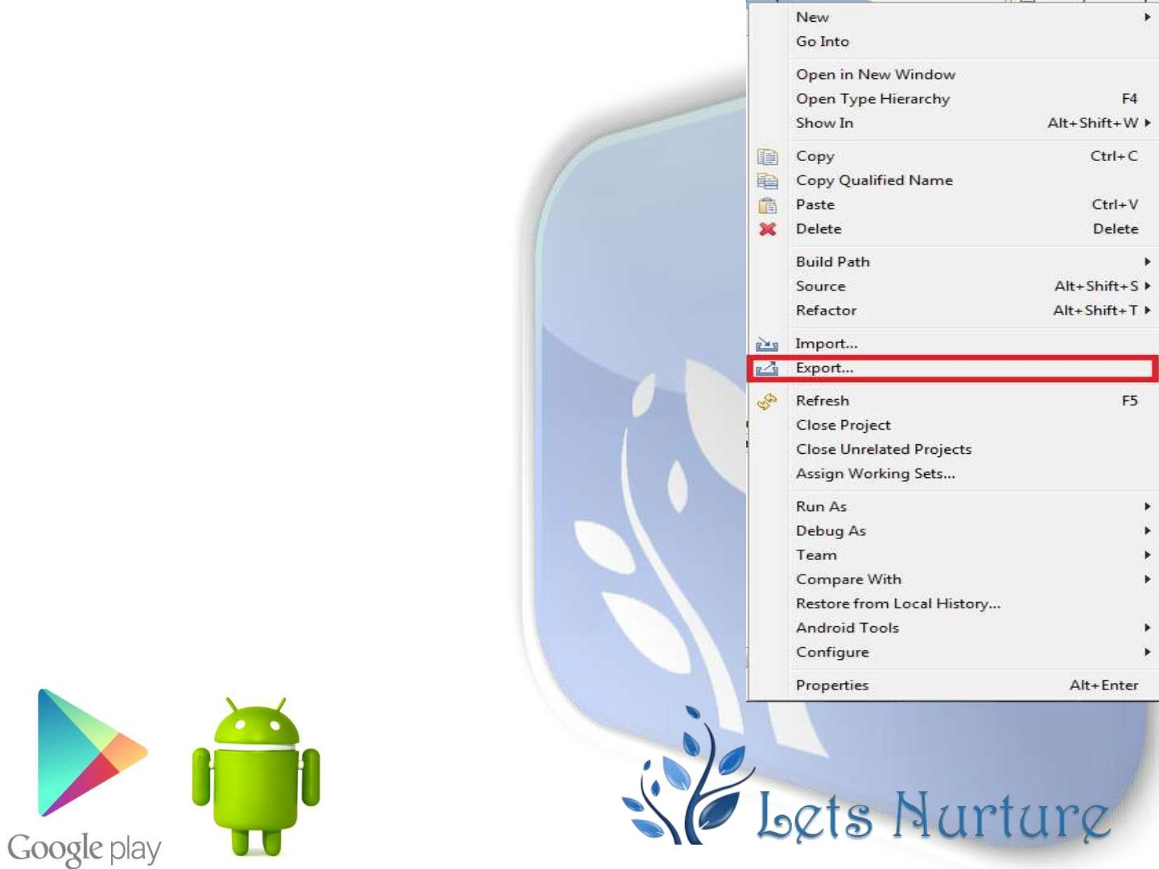
Step 1:
Right click on a project, Go To
EXPORT option that is highlighted
on the image.

Slide 28
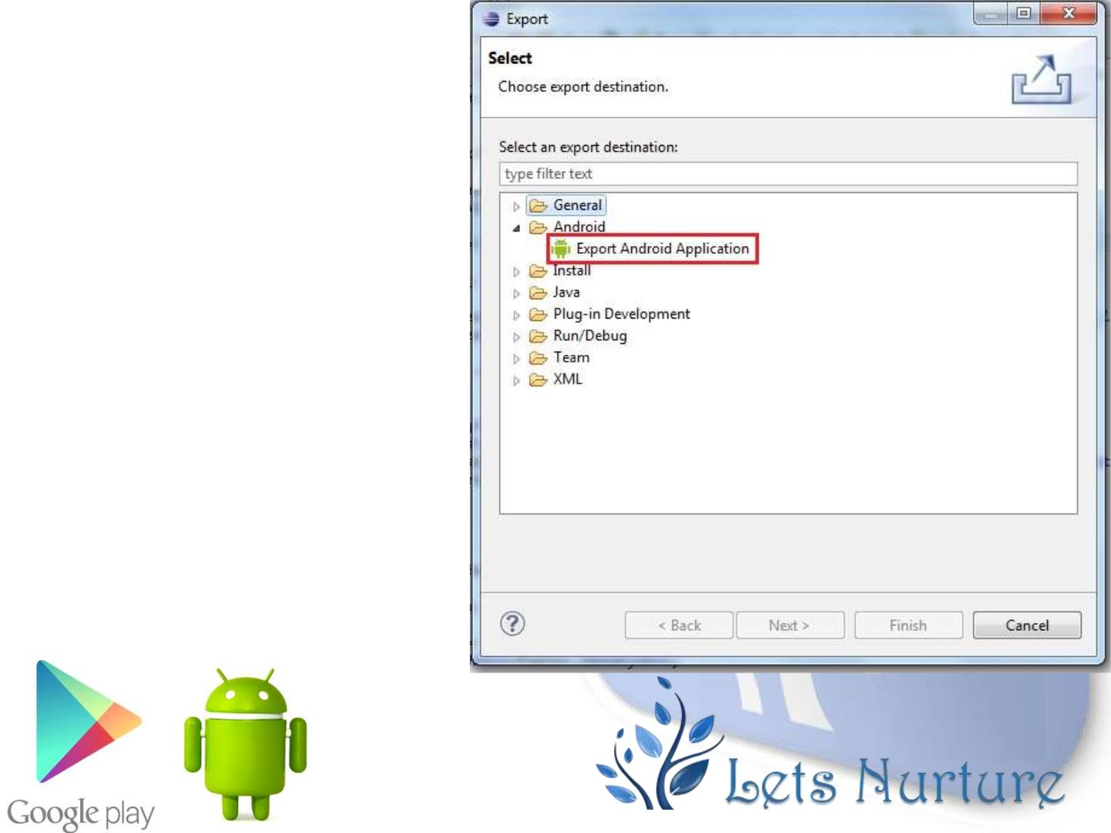
Step 2:
Double click on the
Android folder below
General Folder and
select the EXPORT TO
ANDROID APPLICATION
as shown in figure.

Slide 29
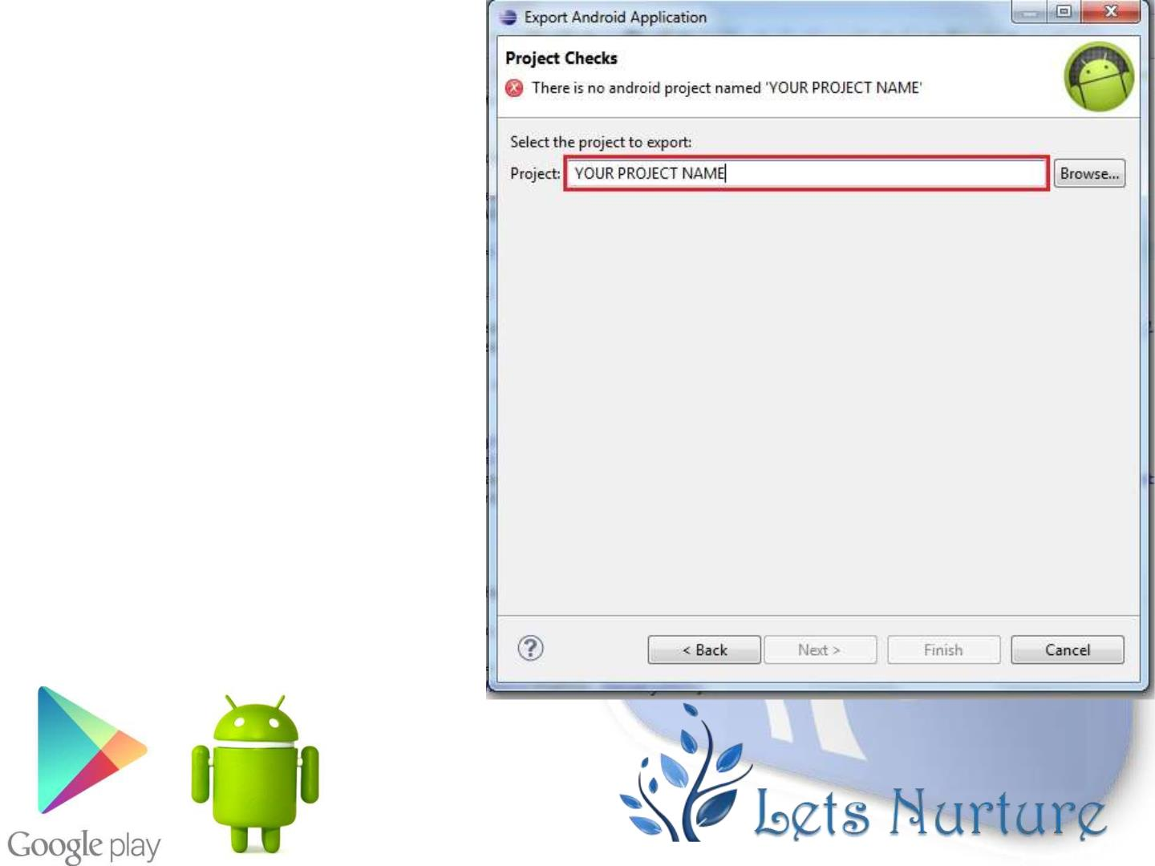
Step 3:
Enter name of the project
in the highlighted area or
browse and show the
project path.

Slide 30
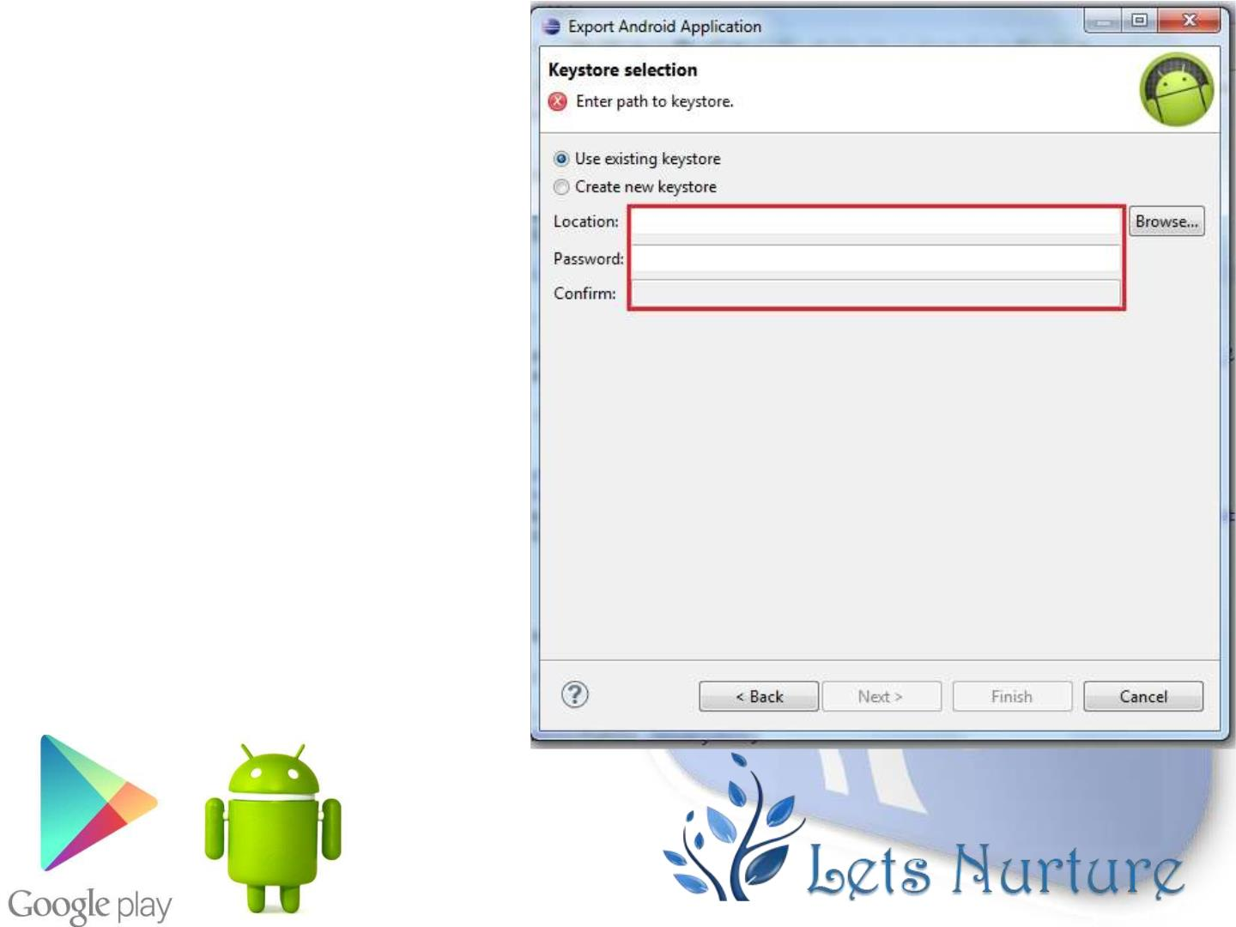
Step 4:
KeyStore Selection
create new key for a fresh
project specify the location
where we want to store the
key and a password for its
encryption.
Note: Keep this key that is generated
to a very safe place as it is the only
authentication for your code to be
yours.

Slide 31
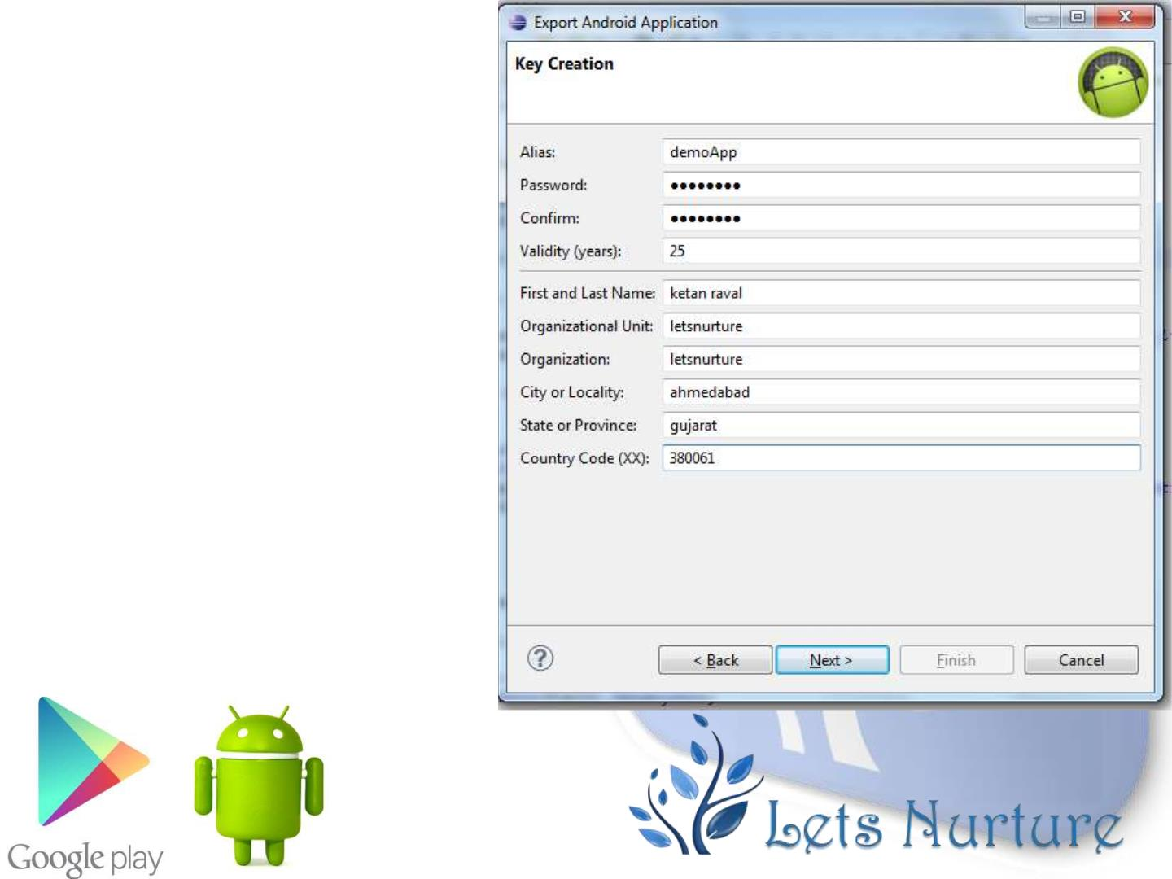
Step 5:
1. Enter All Details for
keys creation
click Next store the apk
file and Bingo….
Its Done. APK is
generated.

Slide 32
Things Required to Publish an App
• There are few things that you need to provide with your application while
publishing it.
• Such as:
✓Listing details
✓ Store Graphics
✓ Screenshots (Minimum 2)
✓ Videos (Optional)

Slide 33
Listing Details
• App Name :- Give suitable app name for your application.
• App Description :- Write suitable description for your app, not
exceeding 4000 characters.
• Category :- It is required that you select an appropriate category for
you application.
• Application Type :- It is also required that you set a category for your
application. This could be either set as application or game
• Organization Name :- It is also required that you mention the name
of organization while filling up the details.
• Support information :- This includes URL , Email, Phone number etc.

Slide 34
Store Graphics
•
App Icon
✓
512 x 512 px
✓ 32-bit PNG
✓
✓
Max size 1024KB
Transparency allowed
•
Promo graphic
✓
180 x 120 px
✓ 24-bit PNG
✓ No border
✓ No Transparency
• Feature graphic This is also optional but is required to get your app featured anywhere. This image has
the following constraints
✓
✓
1024 x 500 px
safe frame of 924 x 400 px
✓ 24-bit PNG
✓ No Transparency

Slide 35
Screenshots
• Screenshots are important because people will see screenshot before installing app
on phone. So it must convey your main functionality.
• Constraints for the screenshots are
✓ 6 additional optional
✓ 480 x 800 px, or 480 x 854 px
✓ 72dpi, RGB, flattened
✓ No transparency
✓ High quality JPEG or 24-bit PNG
✓ No borders
✓ Can show status bar

Slide 36
Video (Optional)
• Finally you can even show how your app works through a video. This can greatly
increase the chances of popularity of your app as the viewer can get synopses of
your application. Google recommends the length of the video to be anything
between 30 seconds to 2 minutes.

Slide 37
Final Check
• Apart from this you need to set some other parameters as well. Like
✓ Size- the size of the app should not exceed 50 Mb
✓ Pricing- you need to decide whether your app should be free or priced.
✓ Country distribution- you get to decide which country or territories your app should be
distributed.
✓ Rating- This is the maturity rating required of your app. You can set is as everyone, low
maturity, medium maturity, high maturity.
• At least once you need to read Google play store policies ☺
• This APK is then uploaded. This includes
✓ Optimization
✓ Building
✓ signing with your release key
✓ Final testing.
• All this and you are good to go.

Slide 38
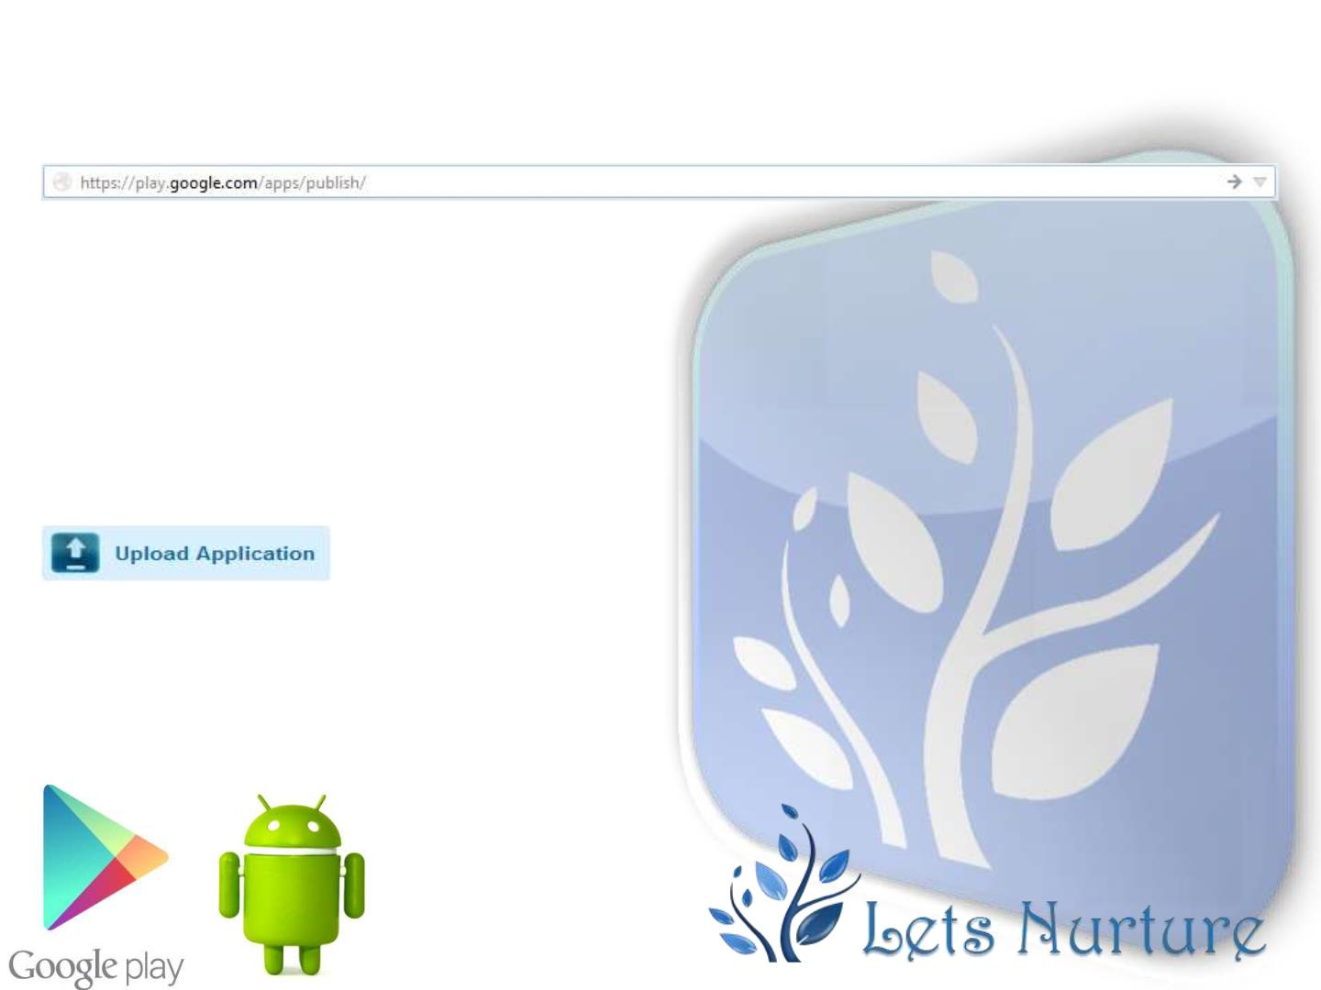
Go to the URL:
Click on the following Button:

Slide 39
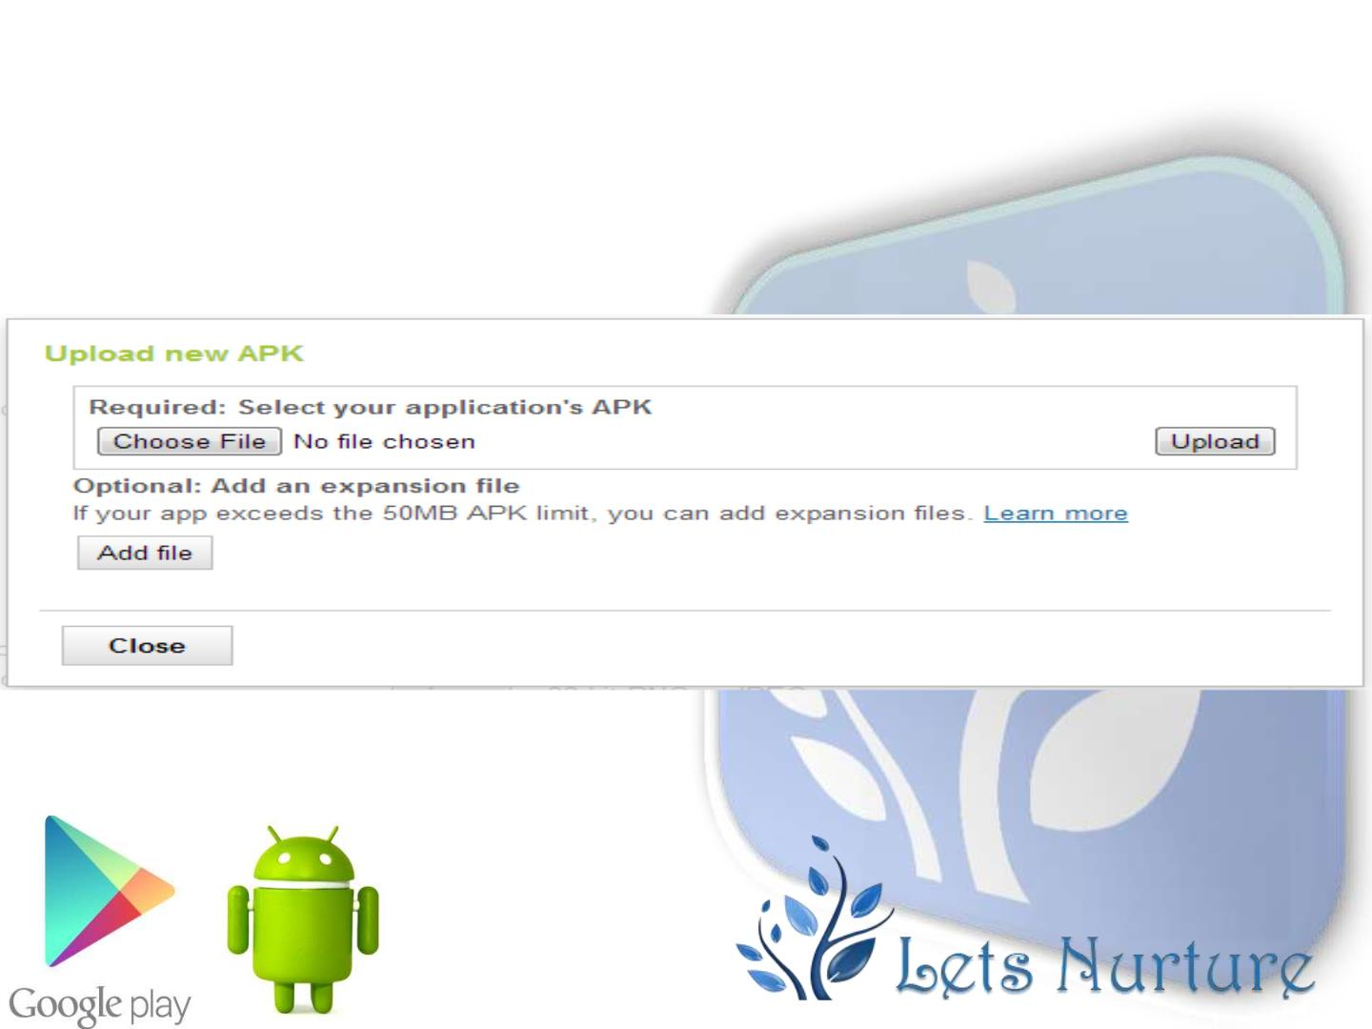
Give the path where your apk file is
placed and click on upload Button:

Slide 40
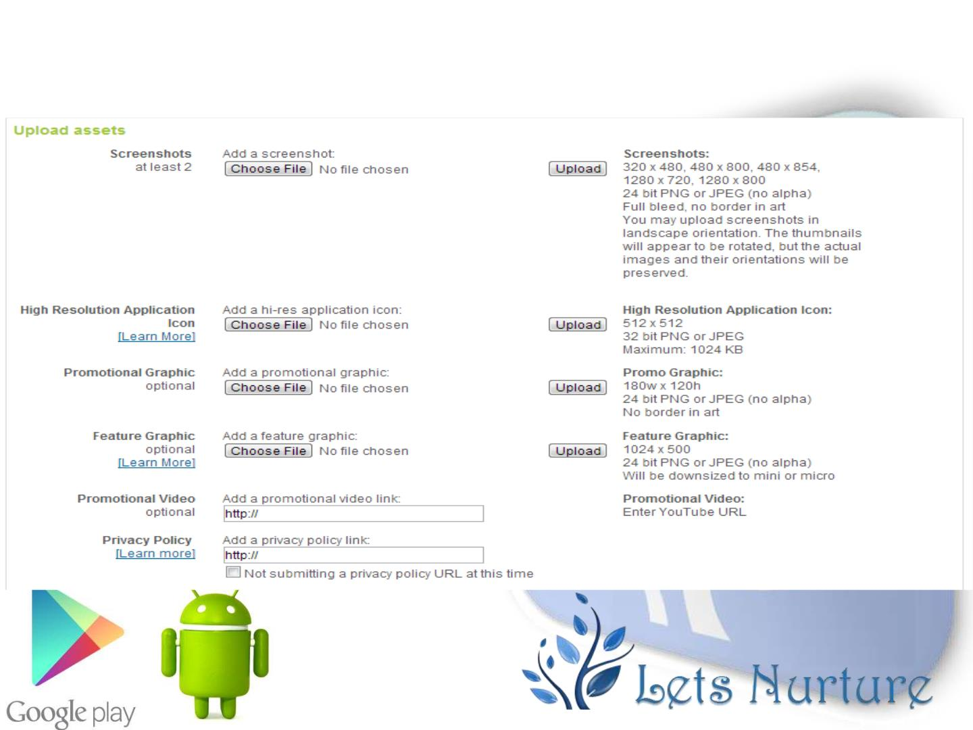
Attach assets of an Application

Slide 41
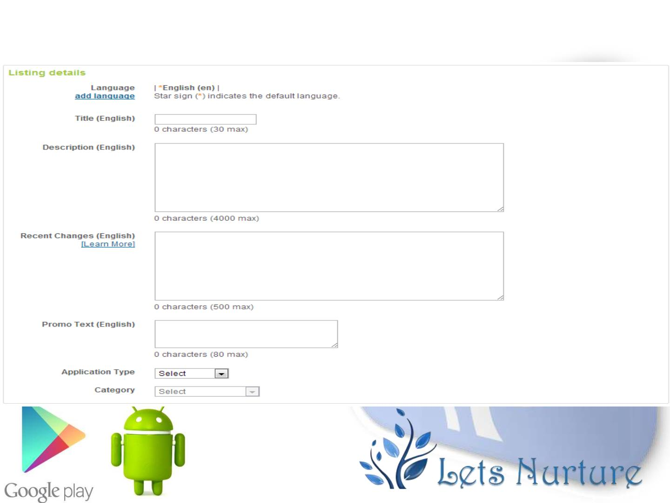
Fillup all Application Listing Details...
Part 1 of 4…

Slide 42
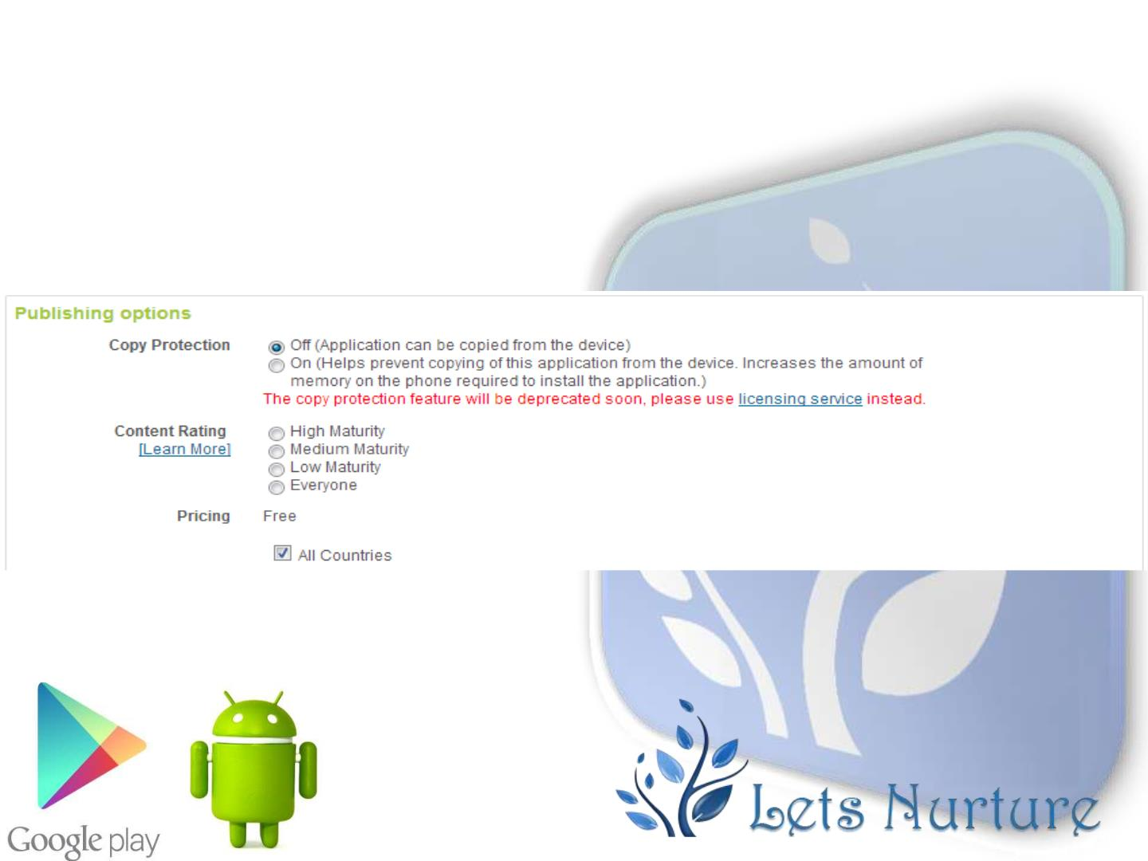
Choose the appropriate publishing options :
Part 2 of 4…

Slide 43
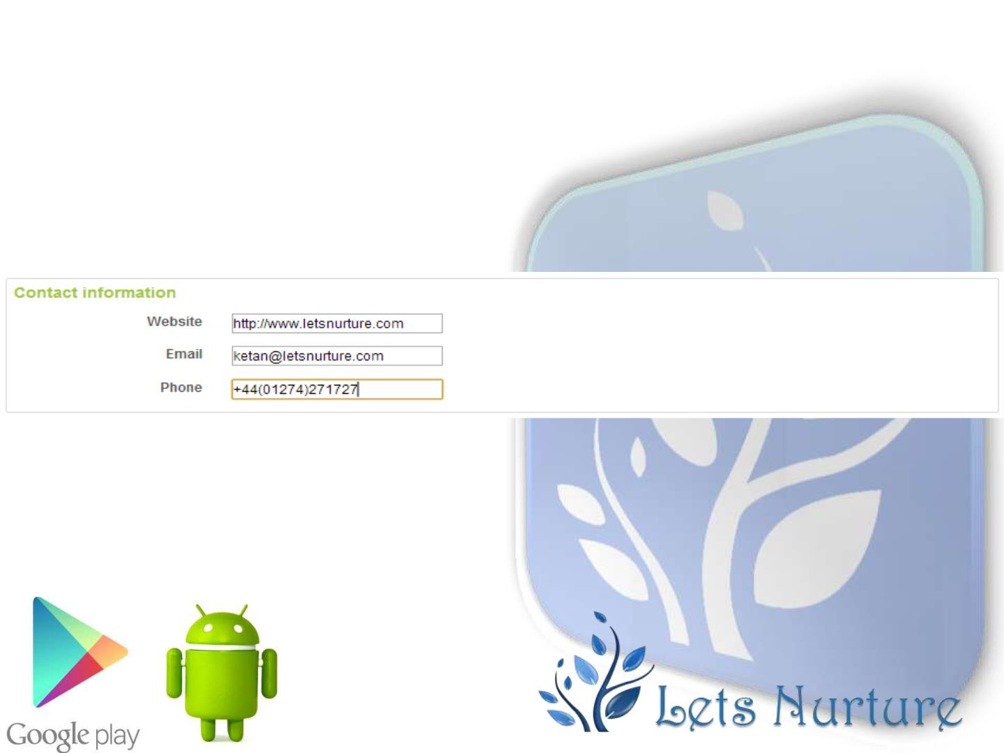
Contact Information :
Part 3 of 4…

Slide 44
At last....
• Once these all processes finished, You have to accept the
agreements. Finally, You can click on publish button to upload your app on
play store.
• Your App will be publish on market within 1-2 hours.

